Slide 1


AstroSage Analysis
Prajyot .P. Naik
29/11/2025

Slide 2
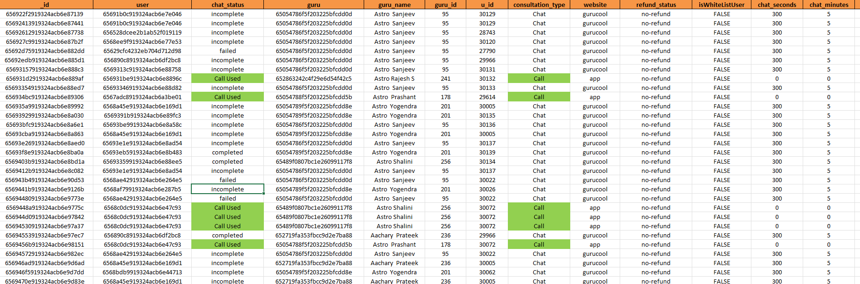
Problem Statement
AstroSage has received a 1 crore investment and aims to optimize its call center operations. The goal is to determine how
to allocate this investment to maximize operational efficiency, customer satisfaction, and profitability. The analysis will consider historical call data, performance metrics, and market trends to make informed decisions.

Slide 3
Data Overview
8,508 Records, 35 Attributes
_id: Unique identifier for each record.
user: User ID associated with the record.
chatStatus: Status of the chat (e.g., incomplete, failed, completed).
guru: Unique identifier for the guru.
guruName: Name of the guru.
gid: Guru ID.
uid: User ID.
consultation Type: Type of consultation (e.g., Chat, Call).
website: Source of the consultation (e.g., gurucool).
Refund Status: Indicates if the session is refundable or not (e.g., no-refund).
is WhiteList User: Boolean indicating if the user is whitelisted.
chat Seconds: Duration of the chat in seconds.
queue: Boolean indicating if the session was queued.
FreeCall: Boolean indicating if the call was free.
Free Chat: Boolean indicating if the chat was free.
CreatedAT: Original creation date and time.
updatedAt: Original update date and time.
__v: Version key.
statementEntryId: Identifier for the statement entry.
chatStartTime: Start time of the chat.
chatEndTime: End time of the chat.
timeDuration: Undefined, some technical data as per app. (Don’t use it as the duration of chat/call)
callChannel: Channel used for the call.
calIvrType: IVR type used during the call.
callStatus: Status of the call.
CallSid: Unique identifier for the call session.
amount: Amount charged for the session.
astrologerCallStatus: Status of the astrologer during the call.
astrologerOnCallDuration: Duration of the astrologer's call.
astrologersEarnings: Earnings of the astrologer from the session.
netAmount: Net amount after deductions.
region: Region of the user.
userCallStatus: Status of the user's call.
userOnCallDuration: Duration of the user's call.
rating: Rating assigned based on the session's status.

Slide 4
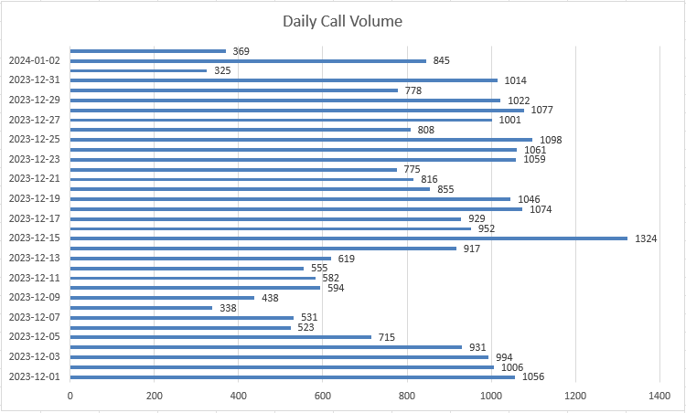
Daily Call Volume
Call Load Analysis
Peak days show demand spikes
Agent capacity doesn’t scale equally

Slide 5
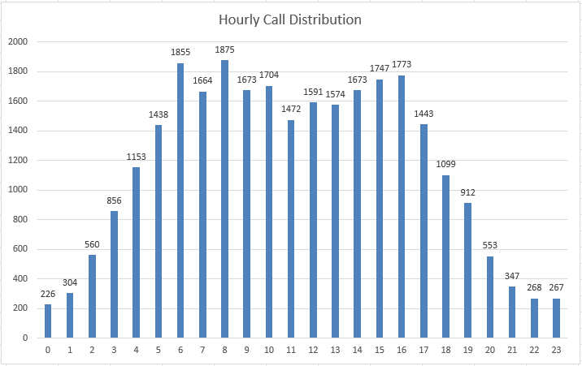
2) Hourly Call Distribution
Call Load Analysis
Peak hours drive failures
Capacity planning needed

Slide 6
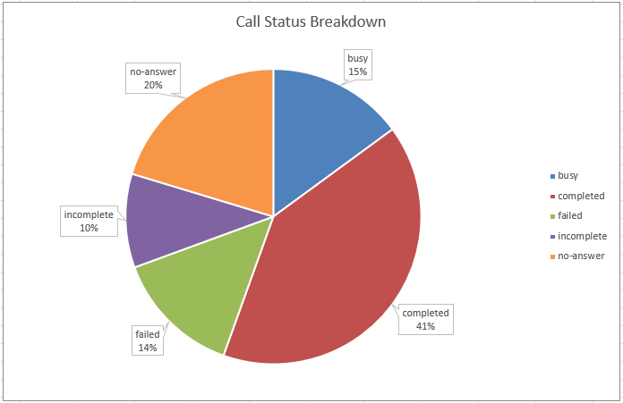
Call Completion Performance
Call Performance
Only 40.55% calls completed
Failures driven by busy/no-answer

Slide 7
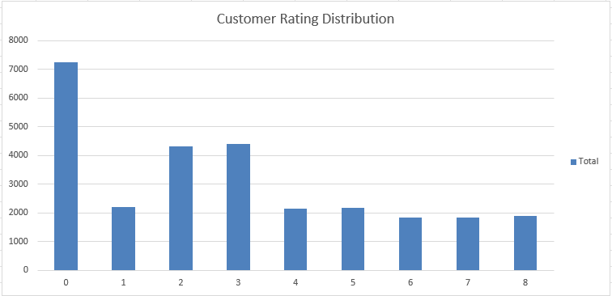
Rating Distribution
Customer Satisfaction
Avg rating = 2.93
Majority ratings between 0–4

Slide 8
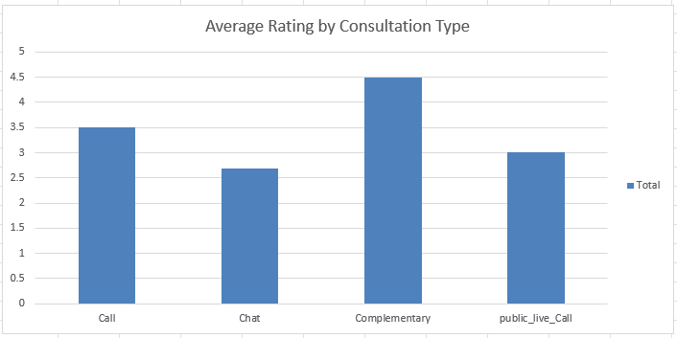
2) Rating by Consultation Type
Customer Satisfaction
Chat outperforms call
Good Experience = Higher rating

Slide 9
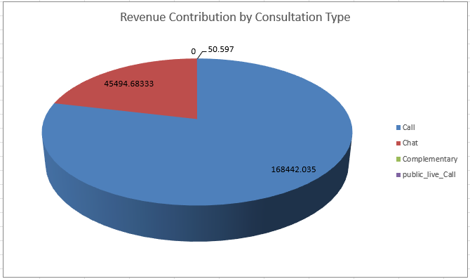
Revenue by Consultation Type
Revenue Impact
Calls generate ~79% revenue
Call success = Revenue driver

Slide 10
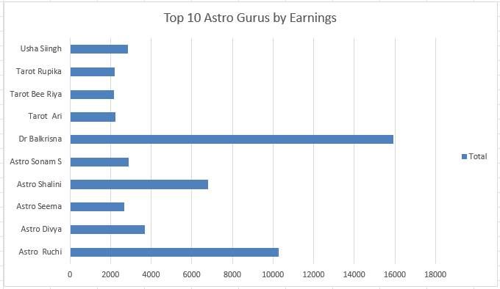
2) Top 10 Gurus by Earnings
Revenue Impact
Revenue concentration among few gurus
Risk of dependency

Slide 11
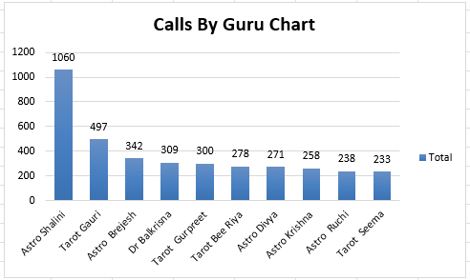
Agents/Gurus Workload Imbalance
Workload Imbalance
Uneven call distribution
Burnout risk during peak hours

Slide 12
Technology Improvements
Workforce & Training Strategy
Strategic Recommendations
Improve call routing & connectivity
Introduce AI chatbots for basic queries
Reduce busy and failed calls during peak hours
Hire experienced Astro
Gurus
Train agents using low-rating insights
Use shift-based scheduling for peak hours

Slide 13
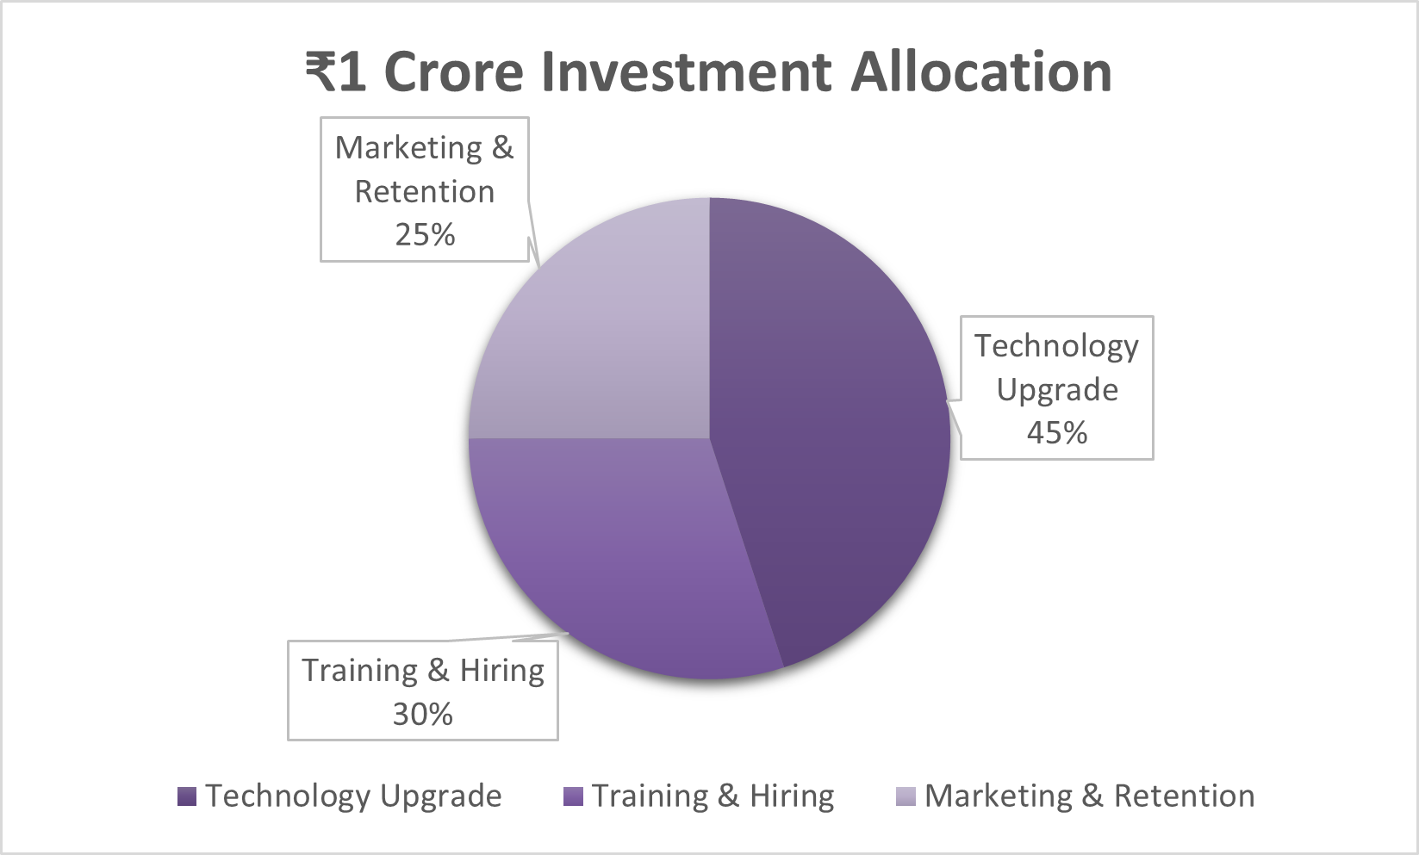
₹1 cr investment allocation
Allocation based on operational bottlenecks & revenue dependency on calls
Investment Allocation

Slide 14
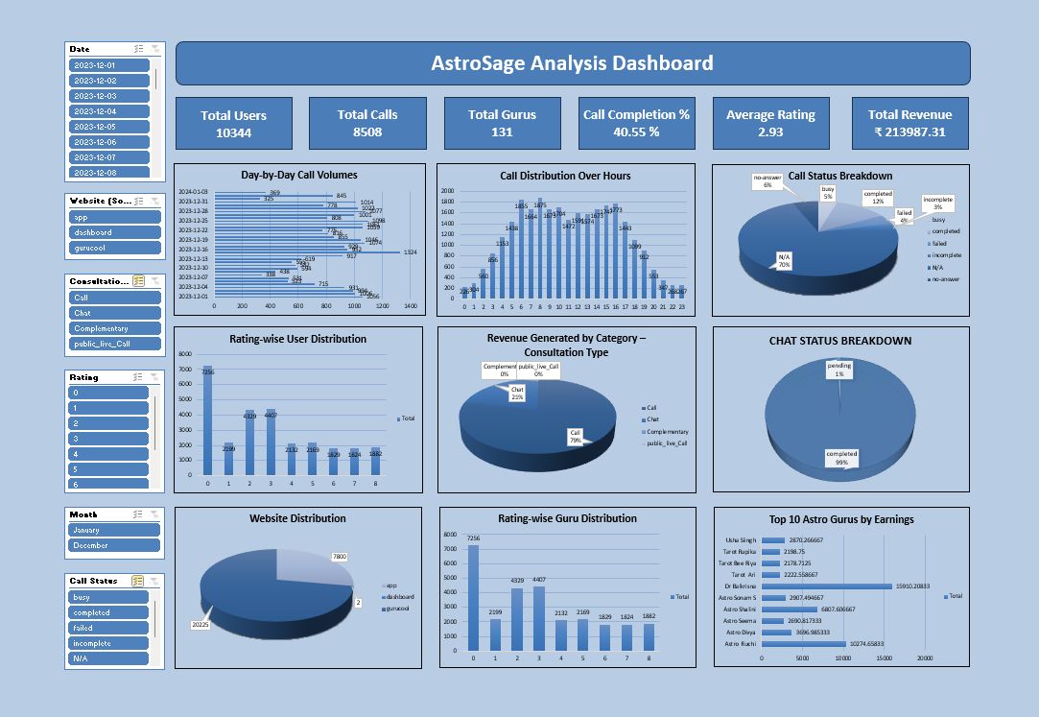
Dashboard Overview

Slide 15
Interactive dashboard with:
Slicers:
Dashboard Overview
KPIs
Time-Based Trends
Call status, ratings, revenue
Date
Website
Consultation Type
Month
Rating
Call Status

Slide 16
Conclusion
This analysis evaluates AstroSage’s call center performance using historical data to assess operational efficiency, customer satisfaction, and revenue impact. Out of 8,508 total calls, only 40.55% were completed, highlighting a significant efficiency gap, particularly during peak days and peak hours. Customer satisfaction is relatively low, with an average rating of 2.93 and most ratings falling between 0 and 4, indicating clear service quality challenges.
From a business perspective, call consultations generate the majority of revenue (₹2.13 lakh), making call performance critical to profitability. Although 131 Astro Gurus handle calls, workload distribution is uneven, with a small group overloaded while others remain underutilised. In contrast, chat consultations show higher satisfaction, suggesting that faster and smoother interactions lead to better user experience.
These insights, supported by an interactive dashboard with KPIs, trends, and slicers, translate into clear action areas: technology upgrades, targeted training, improved workforce allocation during peak hours, and greater adoption of chat-based services. Implementing these measures can improve call completion rates, enhance customer satisfaction, and drive sustainable operational efficiency and revenue growth.

Slide 17
Recommendations
Redistribute calls during peak hours to balance workload across gurus.
Improve training for low-rated gurus using rating and call duration insights.
Upgrade call routing and introduce AI/chatbots to reduce failed and busy calls.
Promote chat consultations to lower call load and improve satisfaction.
Use the interactive dashboard with slicers for continuous performance monitoring
Overall, focused investments in technology, training, and workforce optimization will improve call completion rates, customer satisfaction, and long-term revenue growth.

Slide 18
Thank you
By Prajyot .P. Naik
29/11/2025

